Slide 1


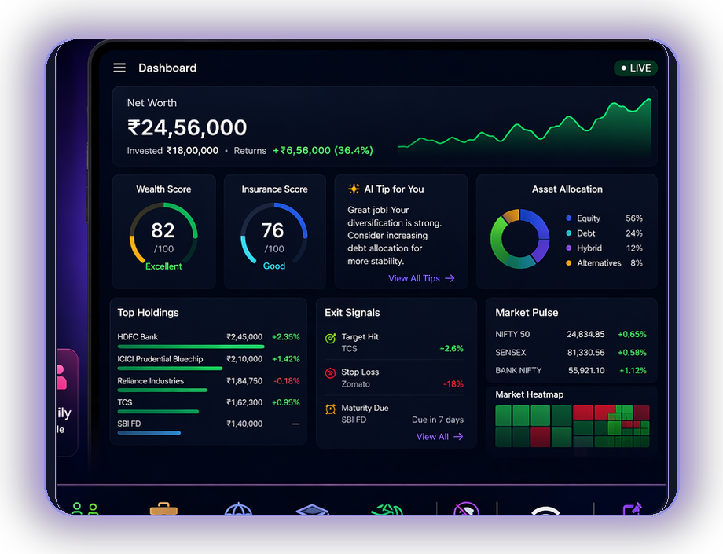

ValeurFin
Master Your Financial Story
WHAT'S IN IT FOR YOU
See every rupee. Know what to do. Keep it private.
ValeurFin brings your investments, taxes, live market moves and family finances into one private dashboard - so you can see more, decide faster and stay in control.
✦ Free · No Signup · Works Offline
12+ asset classes
Live NSE
Works offline
01
Everything in one view
Stocks, SIPs, FDs, PPF, gold, crypto and family finances together.
02
Better decisions, faster
100%
12+
Free
Live prices, tax visibility, scores and exit cues that keep you ahead.
Private & Local
Investment Types
Forever, No Ads
03
Privacy you can trust
Net worth clarity
Tax ready
ValeurBot AI
Exit cues
No signup. No server. Your data stays on your device, even offline.
HOW IT WORKS
1
Add your assets
2
ValeurFin organizes + analyzes
3
You get clarity, action & peace of mind
🌐
Try ValeurFin
Scan to open
valeurfin-app.github.io

